Slide 1
SET THEORY
Session 10
Course : Z0184-Discrete Mathematics
Effective Period : September 2017

Slide 2
These slides have been adapted from:
Susanna S.Epp. (2010). Discrete Mathematics with Applications.4th edition. Thomson Brooks/Cole. USA. ISBN: 9780534359454
Chapter 6
Acknowledgement

Slide 3
On successful completion of this Course, students will be able to:
Learning Objectives
LO 1: Explain the logic of compound and quantified statements and how do to proof
LO 2: Explain and applying Set Theory, Counting method and Number Theory
LO 3: Explain Function, recursion, fuzzy set, Relations and Graph Theory
LO 4: Explain Trees & Graph theory and its application
LO 5: Explain Automata and graph its application in computer science

Slide 4
Set Theory
The introduction of suitable abstractions is our only mental aid to organize and master complexity.
—E. W. Dijkstra, 1930–2002

Slide 5
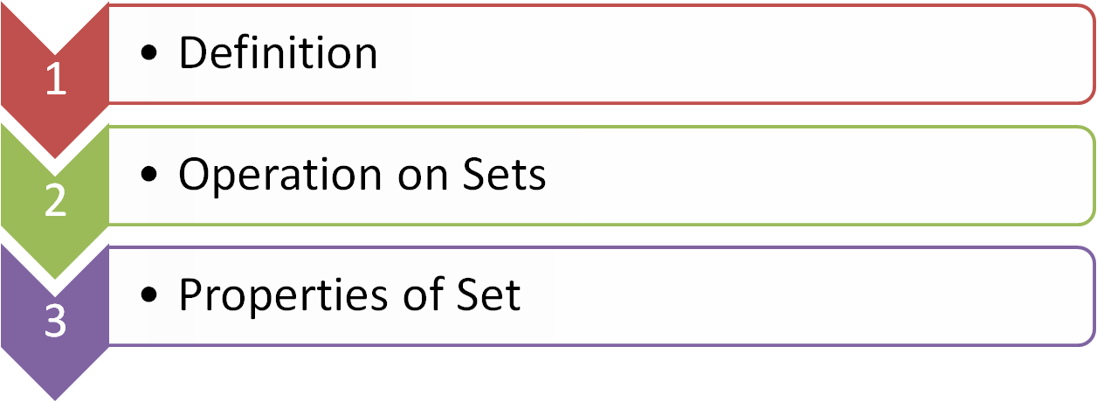

Outline
The Inclusion / Exclusion Rule

Slide 6
DEFINITION

Slide 7
Set Theory
Definition
A set is an unordered collection of elements
x ∈ S means “x is an element of set S.”
x ∉ S means “x is not an element of set S.”
Example:
{1, 2, 3} is the set containing “1” and “2” and “3.”
{1, 1, 2, 3, 3} = {1, 2, 3} since repetition is irrelevant.
{1, 2, 3} = {3, 2, 1} since sets are unordered.
{1, 2, 3, …} is a way we denote an infinite set (in this case, the natural numbers).
∅ = {} is the empty set, or the set containing no elements

Slide 8
Subset and Superset
Definition
A ⊆ B means “A is a subset of B.”
A ⊇ B means “A is a superset of B.”
A = B if and only if A and B have exactly the same elements.
Example:
{1,2,3} ⊆ {1,2,3,4,5}
Is ∅ ⊆ {1,2,3}? Yes
Is ∅ ∈ {1,2,3}? No
Is ∅ ⊆ {∅,1,2,3}? Yes A ⊆ B
Is ∅ ∈ {∅,1,2,3}? Yes
A
B

Slide 9
Ways to Define Sets
Explicitly
{John, Paul, George, Ringo}
Implicitly
{1,2,3,…}, or {2,3,5,7,11,13,17,…}
Set builder
{ x : x is prime }, { x | x is odd }. In general { x : P(x) is true }, where P(x) is some description of the set.

Slide 10
Cardinality
Definition
If S is finite, then the cardinality of S, |S|, is the number of distinct elements in S.
Example:
If S = {1,2,3}, then |S| = 3
If S = {3,3,3,3,3}, then |S| = 1
If S = ∅, then |S| = 0
If S = {0,1,2,3,…}, then |S| = infinite

Slide 11
Power Set
Definition
If S is a set, then the power set of S, P(S), is the set of all subsets of S.
Example:
If S = {a}, then P(S) = {∅,{2}}
If S = {a,b}, then P(S) = {∅,{a},{b},{a,b}}
If S = ∅, then P(S) = {∅}
Note: Cardinality of P is |P(S)| = 2^{|S|}
where |S| is cardinality of S.

Slide 12
Cartesian Product
Definition
The Cartesian Product of two sets A and B is:
A x B = { <a,b> : a ∈ A ∧ b ∈ B}
Example:
If A = {Charlie, Lucy, Linus}, and B = {Brown, VanPelt},
Then
A x B = {<Charlie, Brown>, <Lucy, Brown>,
<Linus, Brown>, <Charlie, VanPelt>, <Lucy, VanPelt>, <Linus, VanPelt>}
.

Slide 13
PROPERTIES OF SETS

Slide 14
Union of Set
Definition
The union of two sets A and B is A ∪ B = { x : x ∈ A v x ∈ B}
Example:
If A = {Charlie, Lucy, Linus}, and B = {Lucy, Desi}, then
A ∪ B = {Charlie, Lucy, Linus, Desi}
.
B
A

Slide 15
Intersection of Set
Definition
The intersection of two sets A and B is
A ∩ B = { x : x ∈ A ∧ x ∈ B}
Example:
If A = {Charlie, Lucy, Linus}, and B = {Lucy, Desi}, then
A ∩ B = {Lucy}
.
B
A

Slide 16
Disjoint of Set
Definition
Sets whose intersection is empty are called disjoint sets
Example:
If A = {Charlie, Linus}, and B = {Lucy, Desi}, then
A ∩ B = ∅. So, A and B is disjoint sets.
.
B
A

Slide 17
Complement of Set
Definition
The complement of a set A is A^{c} = { x : x ∉ A}
Example:
If A = {x : x is bored}, then A^{c} = {x : x is not bored}
.
A

Slide 18
Set Difference
Definition
The set difference is A – B = A ∩ B^{c}
.
U
A
B

Slide 19
THE INCLUSION / EXCLUSION RULE

Slide 20
The Inclusion / Exclusion
Rule (1/3)
Theorem
  If A, B, and C are any finite sets, then
  N(A∪B) = N(A) + N(B) – N(A∩B)
  and
  N(A∪B∪C) = N(A) + N(B) + N(C)－N( A∩B) – N( A∩C) – N(B∩C) + N(A∩B∩C).
A
B
A
A∩B
B
C

Slide 21

Example: The Inclusion/
Exclusion Rule for Two Sets
  How many integers from 1 through 1,000 are multiples of 3 or multiples of 5?
  How many integers from 1 through 1,000 are neither multiples of 3 nor multiples of 5?
  N( A ) : counting the multiples of 3 = 333
  N( B ) : counting the multiples of 5 = 200
  N( A∩B) : counting the multiples of 15 = 66
  a. N(A∪B) = N(A) + N(B) – N(A∩B ) = 333 + 200 – 66 = 467
  b. N(A^{c}∩ B^{c} ) = N((A∪B)^{c}) = 1,000 – 467
A
A∩B
B

Slide 22
Example: Number of Elements in a Intersection
A professor in an advanced computer course takes a survey on the first day of class to determine how many students know certain computer languages. The finding is that out of a total of 50 students in the class, 30 know Java
  18 know C++, 26 know C#
  9 know both Java and C++
  16 know both Java and C#
  8 know both C++ and C#
  47 know at least one of the three languages.
  How many students know none of the three languages?
  How many students know all three languages?
  How many students knows Java and C++ but not C#?
  How many students know Java but neither C++ nor C#?
Java
C#
11
8
10
6
3
2
7
C++
3

Slide 23
Famous Identities
Identity: Commutativity:
A ∩ U = A A ∩ B = B ∩ A
A ∪ ∅ = A A ∪ B = B ∪ A
Idempotent: Associativity:
A ∪ A = A (A ∩ B) ∩ C = A ∩ (B ∩ C)
A ∩ A = A (A ∪ B) ∪ C = A ∪ (B ∪ C)
Domination: Distributivity:
A ∪ U = U A ∪ (B ∩ C) = (A ∪B) ∩ (A ∪ C)
A ∩ ∅ = A A ∩ (B ∪ C) = (A ∩ B) ∪ (A ∩ C)
.

Slide 24
Famous Identities
Excluded Middle: A ∪ A^{c} = U
Uniqueness: A ∩ A = ∅
Double complement: (A^{c})^{c} = A
DeMorgan’s I: (A ∪ B)^{c} = A^{c} ∩ B^{c}
DeMorgan’s II: (A ∩ B)^{c} = Ac ∪ B^{c}

Slide 25
References
Susanna S.Epp. (2015). Discrete Mathematics with Applications.5th edition. Thomson Brooks/Cole. USA. ISBN: 9780534359454

